Slide 1
Expense Tracker
Capgemini assignment
Daniel Oh

Slide 2
Command line based expense tracker
Required:
Adding expense
Show total expense
Show total expense by category
Show expense trend
Show highest and lowest spending category
Approach:
Data kept in file (csv)
LocalDate for date handling
Covered monthly and weekly trends

Slide 3
Architecture
Expense.java: Data model
ExpenseManager.java: calculations, analytics
ExpenseTracker.java: CLI (user interaction)
Design
Separation between UI, logic, data model
Hashmaps for O(1) category lookups
Treemap for monthly and weekly trends (automatic sorting)
Input validation (amount > 0, non-empty fields, date format)
Data storage in file (csv)

Slide 4
Key files
Expense.java
Stores category, amount, date, description
Category normalization (lowercase, trim)
LocalDate for date handling
ExpenseManager.java
Manages a list of expenses in memory
Totals, grouping, trends
Seed data with expenses
Input validation
ExpenseTracker.java
CLI
11 option menu
Output display

Slide 5
Running and testing
From command line:
  Compile: javac src/*.java
  Run: java -cp ExpenseTracker
Testing Process:
  Select option 8 to load sample expenses
  Click on options to test the features
  Can add custom expenses with option 1 to test validation

Slide 6
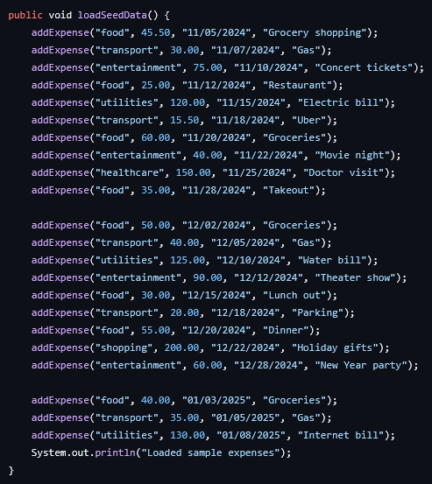
seed data
Includes:
Multiple months
Different weeks of a month
Multiple categories

Slide 7
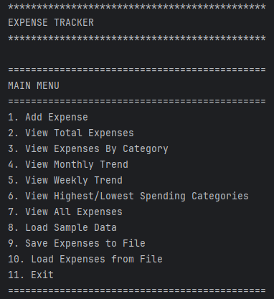
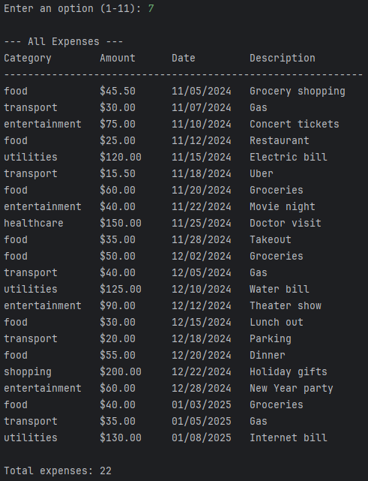
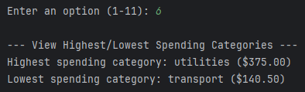
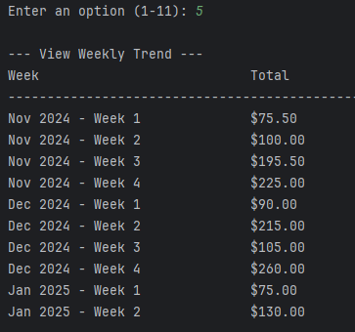

Demo

Slide 8
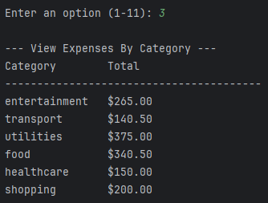
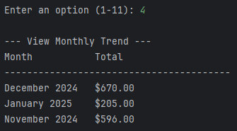
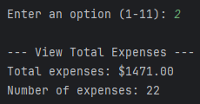
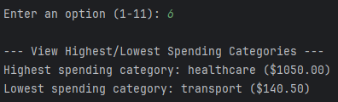
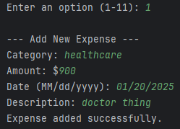
Demo pt. 2

Slide 9
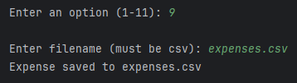
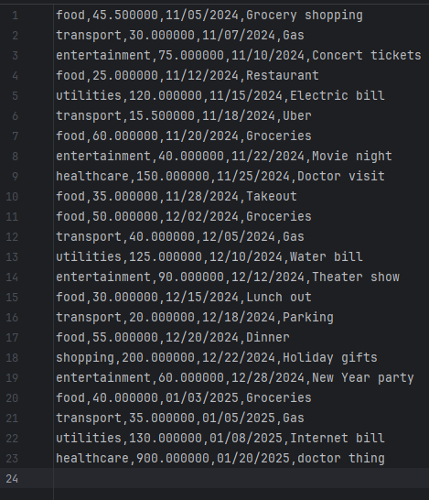
Demo pt. 3
expenses.csv

